Slide 1
Course : T7043 – IT Services
Period : February 2018
Security Management
Session 09
D5664 – Dr. Eng. Antoni Wibowo

Slide 2
The Security Management
Within these processes there are a couple of activities concerning security that have to take place. These activities are done as required. The concerning process and its process manager are responsible for these activities. However, the Security Management will give indications to the concerning process on how these (security specific) activities should be structured.
Bina Nusantara

Slide 3
SECURITY MANAGEMENT
Concept

Slide 4
A basic concept of security management is the information security
The primary goal of information security is to guarantee safety of information. When protecting information it is the value of the information that must be protected.
These values are stipulated by the confidentiality, integrity and availability. Inferred aspects are privacy, anonymity and verifiability.
Bina Nusantara

Slide 5
SECURITY MANAGEMENT
Goal

Slide 6
The Goal of Security Management
The goal of the Security Management is split up in two parts:
The realization of the security requirements defined in the service level agreement (SLA) and other external requirements which are specified in underpinning contracts, legislation and possible internal or external imposed policies.
The realization of a basic level of security. This is necessary to guarantee the continuity of the management organization. This is also necessary in order to reach a simplified service-level management for the information security, as it happens to be easier to manage a limited number of SLAs than it is to manage a large number of SLAs.
Bina Nusantara

Slide 7
SECURITY MANAGEMENT
Standard

Slide 8
Standard
ITIL security management is based on the ISO 27001 standard.
ISO/IEC 27001:2005
" ISO/IEC 27001:2005 is designed to ensure the selection of adequate and proportionate security controls that protect information assets and give confidence to interested parties."
Bina Nusantara

Slide 9
ISO/IEC 27001:2005
ISO/IEC 27001:2005 specifies the requirements for establishing, implementing, operating, monitoring, reviewing, maintaining and improving a documented Information Security Management System within the context of the organization's overall business risks. It specifies requirements for the implementation of security controls customized to the needs of individual organizations or parts thereof.
Bina Nusantara

Slide 10
SNI ISO/IEC 27001:2009
Perbaikan pelaksanaan keamanan system, diusahakan diperbaharui dengan menggunakan SNI ISO/IEC 27001:2009.
Disini ada komponen yang berasal dari ISO 17799 :
    Kebijakan keamanan
    Organisasi keamanan informasi
    Pengelolaan Aset
    Keamanan sumber daya manusia
    Keamanan fisik dan Lingkungan
    Manajemen Komunikasi dan Operasi
    Pengendalian Akses
    Akuisis, pengembangan dan pemeliharaan system informasi
    Manajemen insiden keamanan Informasi
    Manajemen Keberlanjutan bisnis (business continuity management)
    Kesesuaian.
Bina Nusantara

Slide 11
ISO 17799, information security is characterized as
Confidentiality – ensuring that information is accessible only to those authorized to have access.
Integrity – safeguarding the accuracy and completeness of information and processing methods.
Availability – ensuring that authorized users have access to information and associated assets when required.
Bina Nusantara

Slide 12
SECURITY MANAGEMENT
PROSES

Slide 13
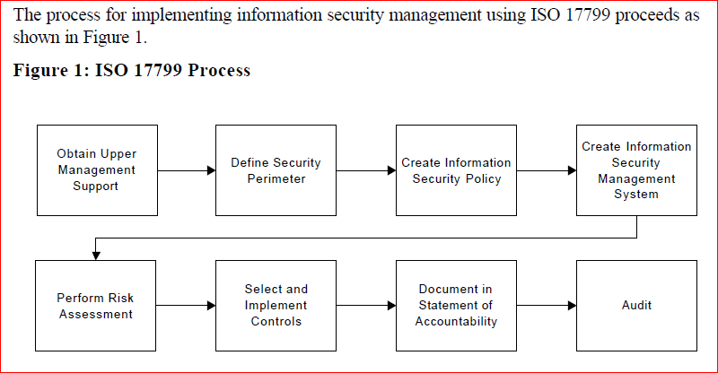
Process ISO 17799
Bina Nusantara

Slide 14
ISO 17799 consists of 10 security controls
Security Policy
Organizational Security
Asset Classification and Control
Personnel Security
Physical and Environmental Security
Communications and Operations Management
Access Control
System Development and Maintenance
Business Continuity Management
Compliance
Bina Nusantara

Slide 15
Developing a Strategic Security Process
Definition:
strategic security is designed to safeguard the availability, integrity, and confidentiality of designated data and programs against unauthorized access, modification, or destruction.
Bina Nusantara

Slide 16
SECURITY MANAGEMENT
Strategic Security

Slide 17
12 step (Developing a Strategic Security)
Identify an executive sponsor
Select a process owner,
Define goals of strategic security,
Establish review board,
Identify, categorize, and prioritize requirement,
Inventory current state of security,
Establish security organization,
Develop security policies,
Assemble planning teams,
Evaluate technical feasibility of plans
Assign and schedule the implementation of plans.
Bina Nusantara

Slide 18
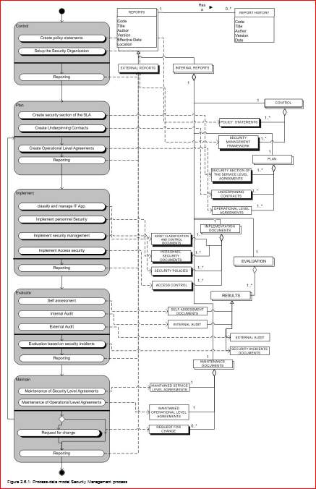
The complete process-data model of the Security Management process.
Bina Nusantara

Slide 19
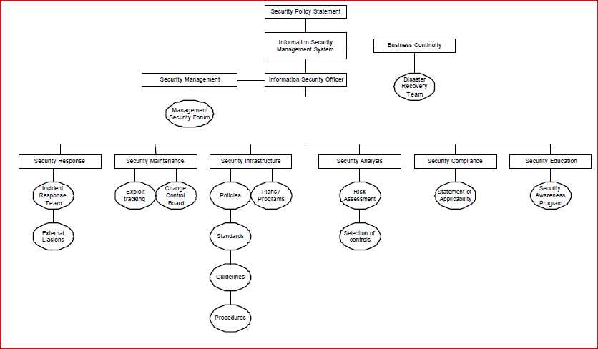
The complete process-data model of the Security Management process

